Slide 1

Why Do People Commit Crime?: An Introduction to Classical Criminology & Rational Choice
Dr Gemma Morgan
Swansea University

Slide 2
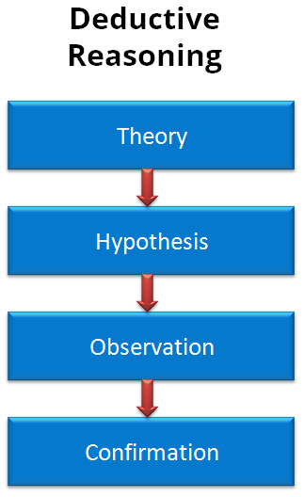
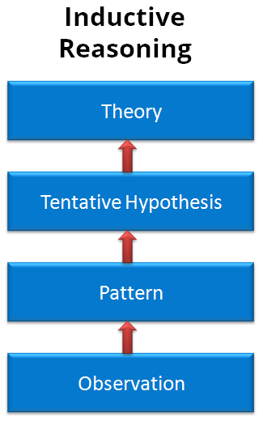
What is theory?
A theory is the framework used to explain observations and make future predictions

Slide 3
What questions does Criminological ‘theory’ try to answer?
Croall (2011) suggests:
What makes people commit crime?
Are people free to choose their actions?
Or are our choices determined by biological, psychological or social factors?
Are offenders different from non-offenders?
Or is crime ‘normal’?

Slide 4
Classical Theory: The Basics
People have free will and make rational choices
Human beings are motivated to maximise pleasure and their actions are determined by weighing up the benefits and costs
Cost/benefit analysis
https://blog.soton.ac.uk/comp6044/2010/11/29/blog-post-6-classical-criminology/

Slide 5
Rational Choice, Jaywalking And Fare Evasion
While you watch this short video on Youtube, think about the following questions:
Can all the choices made by the people shown in the video be described as rational? If not, why not?
https://www.youtube.com/watch?v=6Z2iRAIa2Vo&t=64s

Slide 6
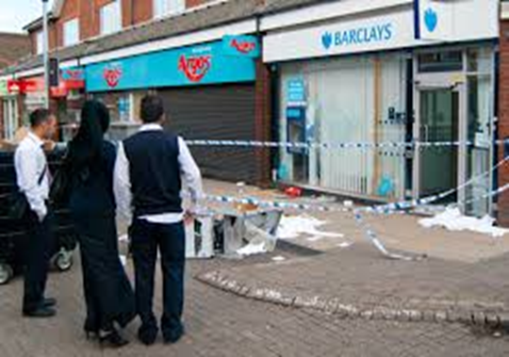
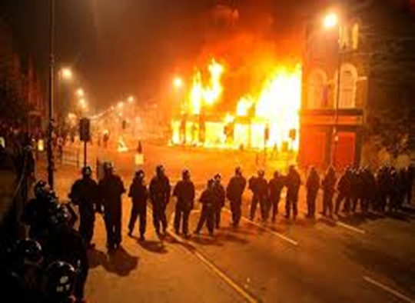
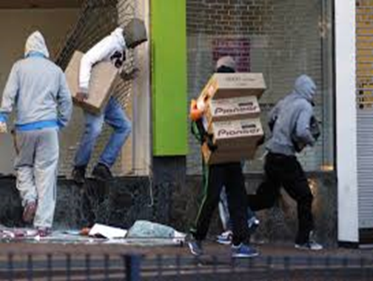
The London Riots and Rational Choice
While you watch this short video on Youtube, think about the following questions:
Can the looting of the young people during the London Riots be described as a rational choice?
What other factors may have affected the young peoples’ decision to loot?
https://www.youtube.com/watch?v=Jg1c6ZY5jFc

Slide 7
Assessing Rational Choice: Limited/bounded rationality
Decisions are influenced by individuals perception of the opportunity
Past experiences affect decision making and information may be inaccurate
Drugs and alcohol may also have an effect
Thus rationality is ‘bounded’ or ‘limited’
This is a modified form of classicism: “individuals make choices in pursuit of their interests, yet the choices available to individuals, as well as their ability to assess them accurately, may be limited” (Tillyer, 2011:147).

Slide 8
Summary: Beyond Classical Criminology and Rational Choice
What other factors can be attributed to explaining why people commit crimes?
Do they these other factors explain all types of offending?

