Slide 1
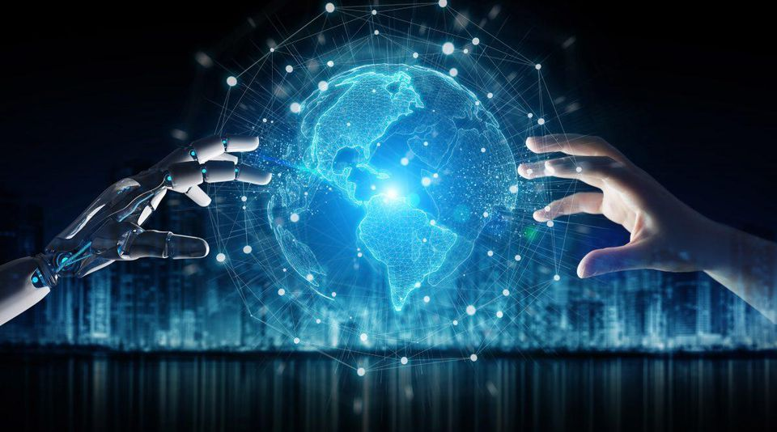
Virtual Tug of War
Ashton Kingdon
University of Southampton

Slide 2

Beneath the echo chamber

Slide 3


Atomwaffen Division
Redneck Revolt

Slide 4
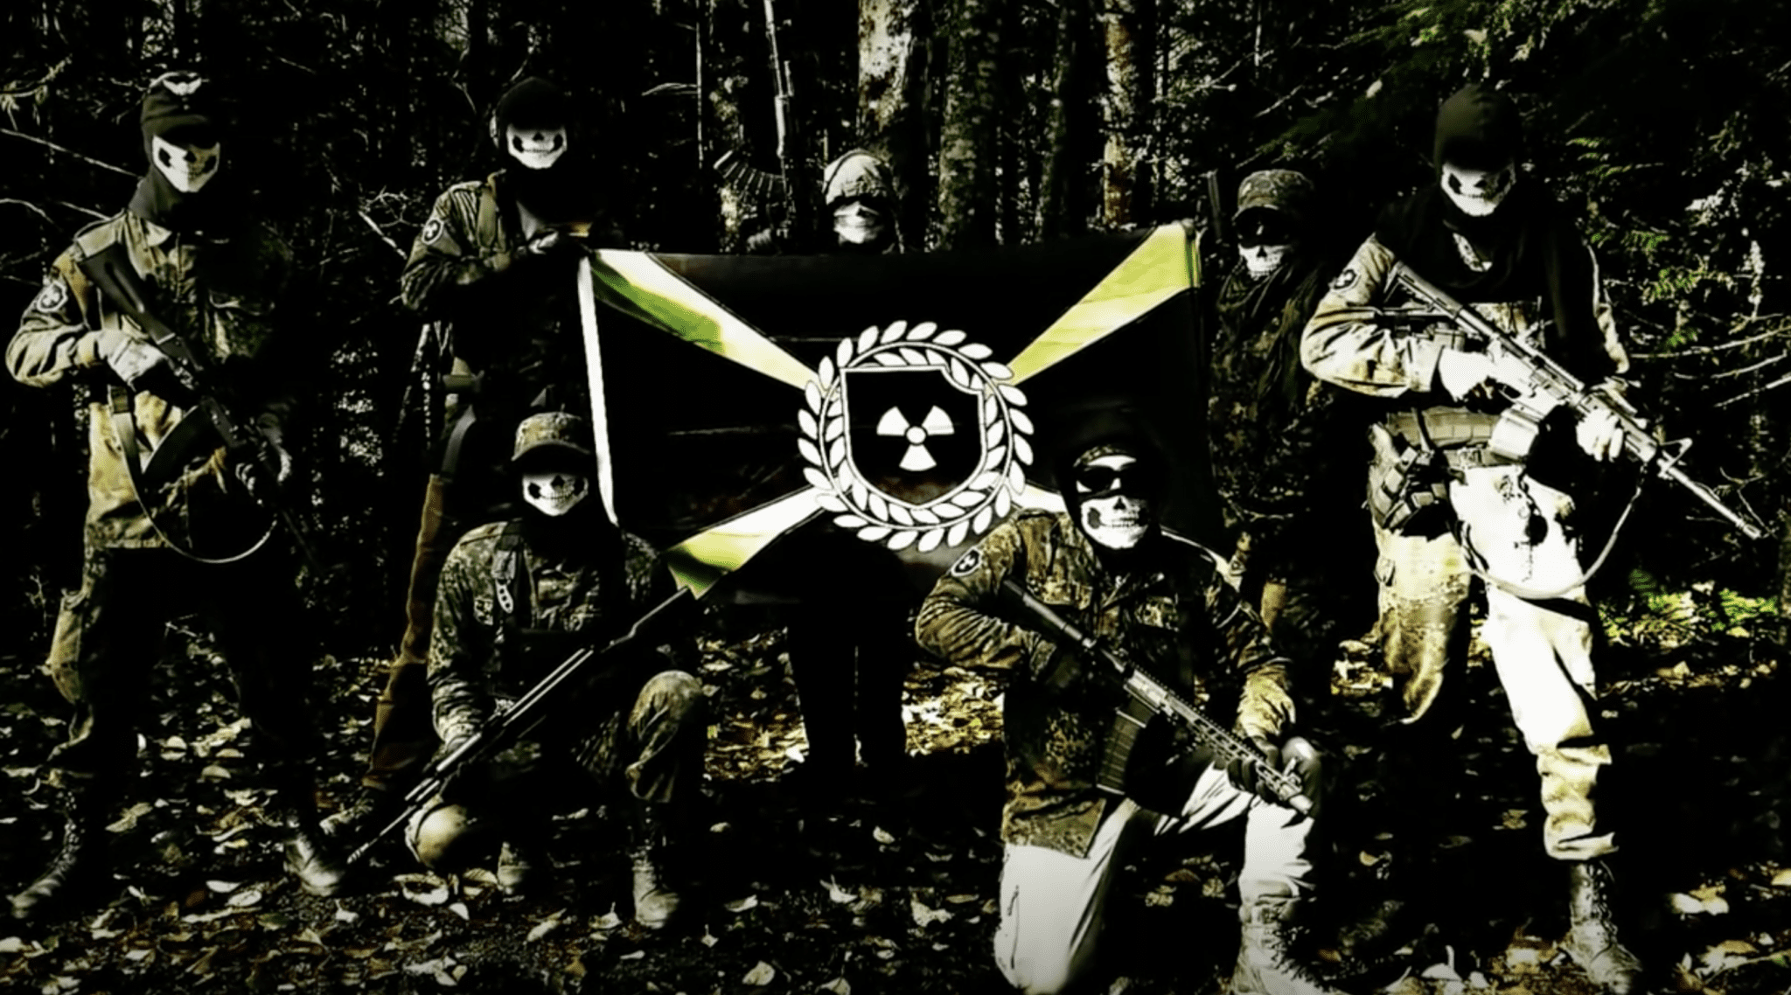

Slide 5
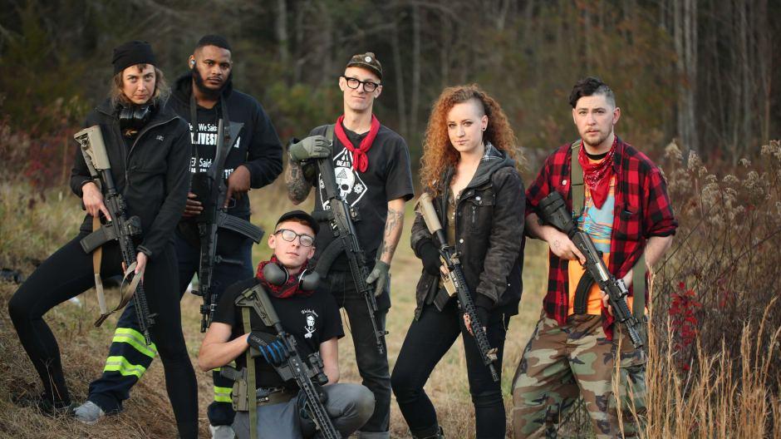

Slide 7


The Kalashnikov

Slide 8

The ar-15

Slide 9





Slide 10
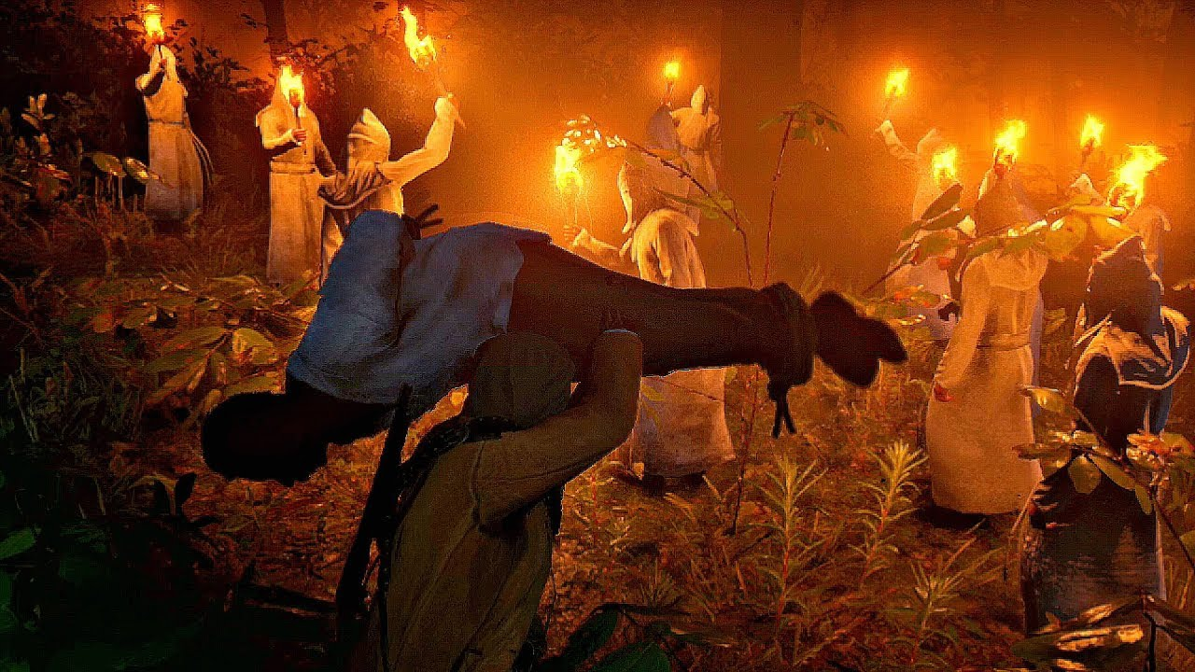



Slide 11
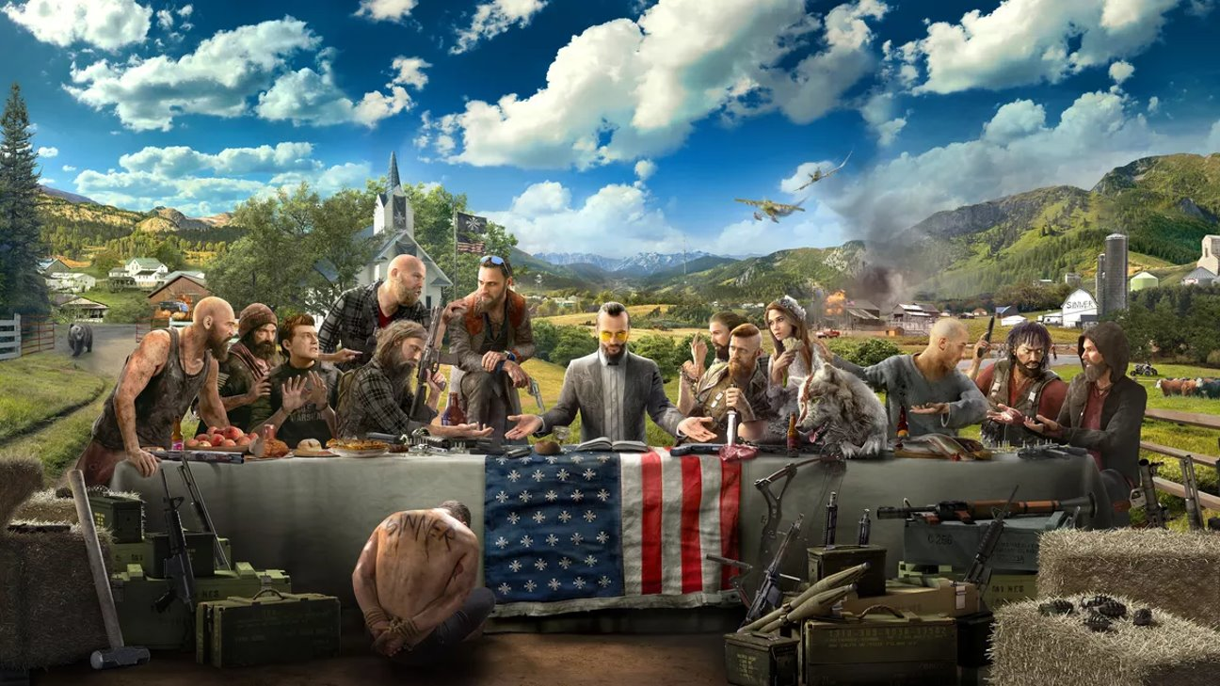

Slide 12

the radicalisation rabbit hole

Slide 13

Key Points
Data is the Fuel for Machine Learning
Most machines/algorithms are not inherently biased or unethical, but the data and training they are given can make them that way
Our algorithms will only ever be as good as the data we put in them
Can we really hold intelligent machines accountable for radicalisation?

Slide 14
Key Points
For AI to prosper it must be EXPLAINABLE
AI will always be embedded within a socio-technical context
In order to successfully counter extremism we need the best of human intelligence and the best of machine intelligence

Slide 15
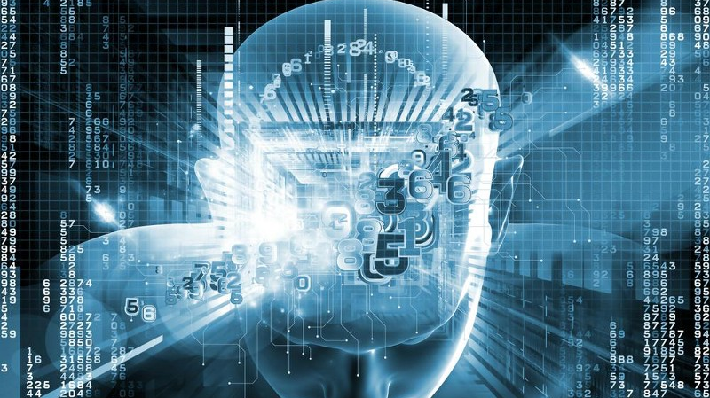

Augmented intelligence

Slide 16
