Slide 1
What About The Private Sector?
Gianluca Riglietti – Head of Research & Intelligence at PANTA RAY
Kamal Muhammad – Research& Insight Analyst at The BCI

Slide 2
Today’s agenda
Monitoring crises
Monitoring terrorism
Crisis communications
Sharing intelligence
Escalating information

Slide 3


Previous works
Growing use of SMM
Call for SMM
Need for more discussions
Market research
Mainly reputational use
Purely theoretical works

Slide 4
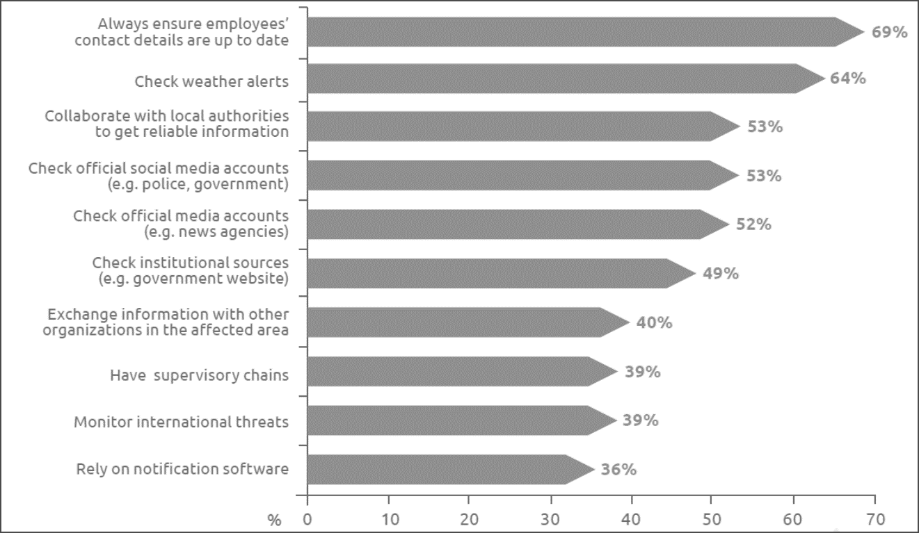
Gathering information during a crisis
Official social media account
External exchange of information
Official media account

Slide 5
Risk and threat assessments
42% use social media monitoring in their risk and threat assessment process
Source: BCI Horizon Scan 2019: Gathering information during a risk and threat assessment (N=334)

Slide 6
Selecting the sample
Overall number of respondents
Respondents using social media
Respondents willing to share their experience
Final count (N=15)

Slide 7

Automation vs manual monitoring
67% rely on social media software
25% have an internally developed app
33% rely on manual monitoring

Slide 8
Who’s in charge?
Health and safety
Risk management
Physical security
IT security
Operations
Stakeholder relations
Business continuity
Crisis management
Comms
Operational resilience
Notes:
Escalation to: top management, internal staff, external consultation

Slide 9








Platforms

Slide 10



Validation
Commercial messaging apps with peers
Boots on the ground
Traditional media

Slide 11
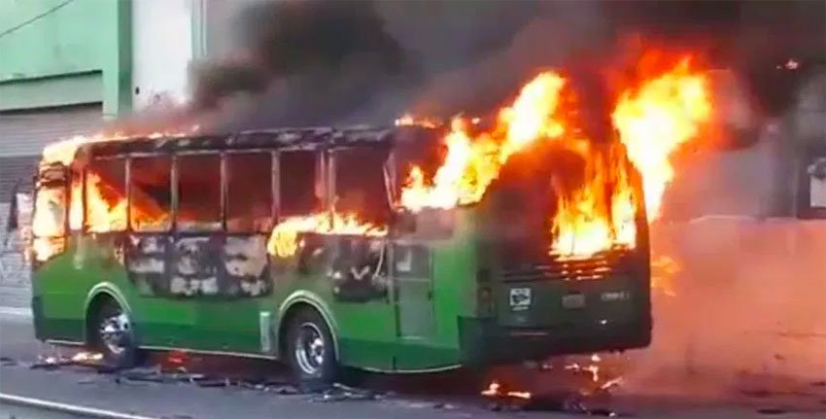
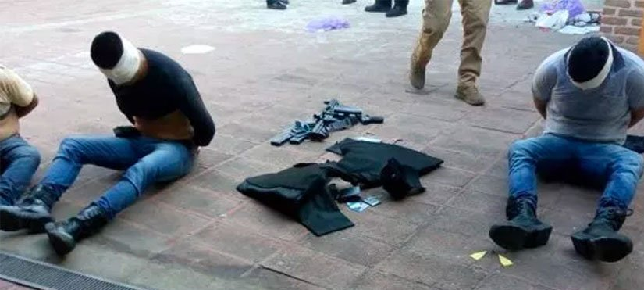
Narco Blockade
Intelligence sharing via messaging apps
Roads blocked and gunmen at large
Followed an assassination attempt

Slide 12
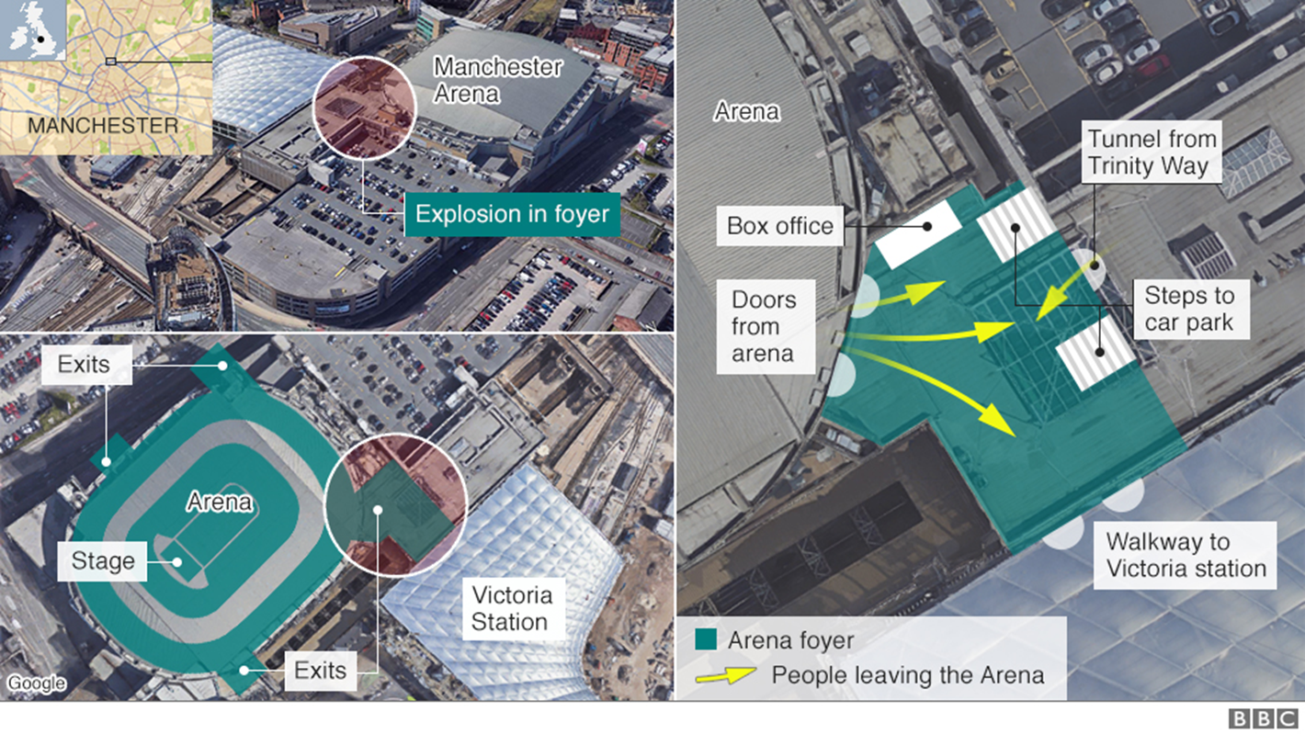
Manchester Arena Attack
Had facilities and staff near the impacted area
Used Yammer to reach out to staff
Activated the business continuity plan

Slide 13
In a snapshot
Establish process owners
Monitoring procedures
Escalation procedures
Validation procedures
Internal platform
External platform
Manual monitoring
Top management
Staff
External Stakeholders
Boots on the ground
Messaging apps
News channels

Slide 14

What about the future?
Internal responsibility
Building a community effort
Emergency notification
Inter-organizational communication

Slide 15






Contacts
Via Antonia Pozzi, 4 – 20149, Milan – Italy Tel.: +39 02 3653 7250 Fax: + 39 02 3653 7254 E-mail: gianluca.riglietti@pantaray.eu
kamal.muhammad@thebci.org
www.pantaray.eu
Follow us:

Slide 16

Disclaimer
The information contained herein is subject to change and may be rendered inaccurate for many reasons, including, but not limited to product and service changes, new service and/or product releases, product differences between differing manufacturers, software and hardware changes, or the like. PANTA RAY assumes no obligation to update or otherwise correct or revise this information. However, PANTA RAY reserves the right to revise this information and to make changes from time to time to the content hereof without obligation of PANTA RAY to notify any person of such revisions or changes.
PANTA RAY MAKES NO REPRESENTATIONS OR WARRANTIES WITH RESPECT TO THE CONTENTS HEREOF AND ASSUMES NO RESPONSIBILITY FOR ANY INACCURACIES, ERRORS OR OMISSIONS THAT MAY APPEAR IN THIS INFORMATION.
PANTA RAY SPECIFICALLY DISCLAIMS ANY IMPLIED WARRANTIES OF MERCHANTABILITY OR FITNESS FOR ANY PARTICULAR PURPOSE. IN NO EVENT WILL PANTA RAY BE LIABLE TO ANY PERSON FOR ANY DIRECT, INDIRECT, SPECIAL OR OTHER CONSEQUENTIAL DAMAGES ARISING FROM THE USE OF ANY INFORMATION CONTAINED HEREIN OR FOR THE PERFORMANCE OR OPERATION OF ANY PERSON, INCLUDING, WITHOUT LIMITATION, ANY LOST PROFITS, BUSINESS INTERRUPTION, DAMAGE TO OR DESTRUCTION OF PROPERTY, OR LOSS OF PROGRAMS OR OTHER DATA, EVEN IF PANTA RAY IS EXPRESSLY ADVISED OF THE POSSIBILITY OF SUCH DAMAGES.
© 2016 PANTA RAY SRL. PANTA RAY, the trademark and logo are property of Panta Ray S.r.l. Via Antonia Pozzi, 4, Milano, VAT IT06451450966. Using, copying or reproducing the above materials and the trademarks without Panta Ray’s consent are expressly prohibited.
Other product and company names are for informational purposes only and may be trademarks of their respective companies.

