Slide 1
Making Change Through Research and Impact
Associate Professor Debbie Jones and Professor Tracey Sagar
Department of Criminology,
Swansea University

Slide 2
Research Exercise Framework (REF)
In the REF, impact is defined as an effect on, change or benefit to the economy, society, culture, public policy or services, health, the environment or quality of life, beyond academia. ...
Impact has been considered a beneficial addition to the REF and will be worth 25% in the REF2021 assessment.
Notes:
Impact has become a prominent feature in the Research Exercise Framework for 2021-
For those of you that don’t know what Ref is – The Research Excellence Framework (REF) is the UK's system for assessing the excellence of research in UK higher education providers (HEPs).
The REF outcomes are used to inform the allocation of around £2 billion per year of public funding for universities' research.
In terms of impact - Introduced in 2014 – Ref sought to assess the impact of academic research on the economy, society, culture, public policy or services, health, the environment or quality of life, beyond academia. ...
2

Slide 3
‘Be Bold’
“The REF exercise offers institutions the opportunity to showcase exciting, novel, and adventurous impacts that have been founded in pioneering research.
UK research can only benefit from having at hand impact case studies highlighting the full dynamism of the changes that research is enabling.”
Institutions must be bold with impact in REF 2021 - REF 2021
Notes:
Indeed according to a Blog on the REF website, the call for 2021 is to be bold in terms of impact
So given the call to be bold we want to talk today about how impact can be made through public education mechanisms when dealing with sensitive and often controversial topics –
for us in this presentation the focus is research that seeks to examine the topic of sex work and in particular we want to discuss how public education can help to bring about impact both to satisfy the REF requirement and also empower those whose lives we are privileged to be part of.
3

Slide 4
Research
2010: ‘Reaching out to female street sex workers in Cardiff: Findings from ‘engagement events’ (Cardiff Sex Work Forum)
2010 : ‘Community Perceptions of Street Sex Work in Cardiff‘(Welsh Government)
2011: ‘Off Street Sex Work in Cardiff: Identifying Service Provision Needs’(Mac Aids)
2011: ‘Locating Female Black and Minority Ethnic Off Street Sex Workers in Cardiff’ (Welsh Government)
2010-2014: ‘Sex Work Research Wales’ (Big Lottery Research Fund)
2014-2015: ‘Sex Work and Substance Misuse’ (Phase 1 and Phase 2) (Welsh Government)
2012-2015 ‘The Student Sex Work Project’ (Big Lottery Innovation Fund)
Notes:
Introduce the research so far and just say so you can see we have been busy in Wales but today the presentation focuses on one project. TTSWP. But we would be very happy to talk about the other projects and the impact in the Q&A or by follow up email.
4

Slide 5
Where to begin to make impact? Participatory Action Research and Sex Work
In UK, over last 15 years PAR has become the overriding methodological framework in relation to sex work research
Advocates: Teela Sanders, Jane Pitcher, Rosie Campbell, Phil Hubbard, Jane Scoular, Nick Mai and Laura Agustin
Maggie O’Neill (2001:47) PAR is: “A combination of experience and commitment [that] allows us to see and shape the relationship between knowledge and social change.”
Notes:
So how do we begin to make impact?
For us it starts with the methodological approach to the study
The work conducted by Jane Pitcher, Rosie Campbell, Phil Hubbard, Maggie O’Neill and Jane Scoular focused on the relationship between the communities and sex workers and was informed by participatory approaches.
Nick Mai and Laura Augustins work with migrant sex workers- have provided life histories which have challenged dominant ideologies in relation to trafficking.
But the primary advocate of action research in relation to sex work in the UK was Maggie O’Neill. And in this definition we see the link to impact in the context of research where Maggie points out that this approach can bring about social change.
5

Slide 6
Huang (2010:93), AR is:
“An orientation to knowledge creation that arises in a context of practise and requires researchers to work with practitioners.
Unlike conventional social science, its purpose is not primarily or solely to understand social arrangements, but also to effect desired change as a path to generating knowledge and empowering stakeholder.”
Notes:
And in this quote from Huang (2010:93), we see action research as the creation of knowledge that requires collaboration with stakeholders. Not something that is a solitary activity of the academic from the ivory tower.
Indeed Huang also suggests that an action research approach isn’t focused primarily on the need for social science to understand social phenomena but should be ultimately concerned with effecting desired change and empowerment.
So perhaps in effect it is it is a research practice with a social change agenda and this is the approach we have taken with our research.
6

Slide 7

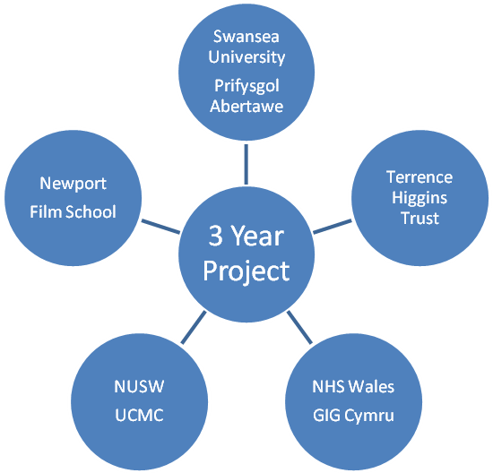
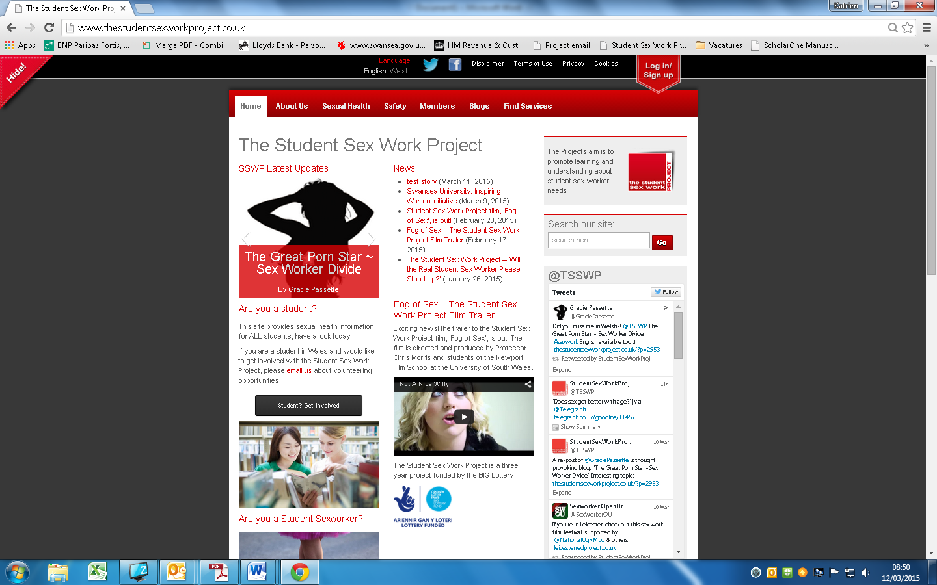

Research and Service Delivery = Innovation and Public Engagement
Interagency; interdisciplinary
First cross sector e-health service
Innovative research - combination of research and service delivery:
Data Collection – Quantitative and Qualitative
Website
Member’s Forum
Net-reach services
Online counselling
Methodology – PAR
“To promote learning and understanding about
student sex worker needs and associated issues,
and to provide an innovative sexual health service to
a marginalised population through an
ethical, empowering research led framework.”
Notes:
Pioneers of PAR - add a bit of our own experience in that when you expand this to bring in services and the various forms of public education that we did we found ourselves being pioneers not just in terms of sex work research but also for the university - which came along with us and had to grow with us - sometimes kicking and screaming - because its vision of impact wasn't exactly what we had in mind
The TSSWP had impact built in from day one – we developed our own services which were evidence led. We worked with and employed SSWs who were part of the project. We carried out research that was then used to inform training packages and we worked with key stakeholders such as NUS Wales to work towards reducing stigma experienced by SSWs.
7

Slide 8
Immediate impact and social inclusion
“When I think about The Student Sex Work Project I still think of them with relief.
Relief that is still with me three years on. Relief that will stay with me forever actually.
That's probably quite a bold statement to make but it's true.
Before I started speaking to the project I was working in absolute isolation.”
Notes:
8

Slide 9
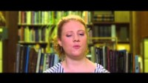
Creative Dissemination
Training- video diary
Festivals
Film screenings with Q&A – Fog of Sex
Beth’s story https://www.youtube.com/watch?v=Iv-rCoTz9Mo
Notes:
but by combining cutting edge methodologies and public engagement and social media mechanisms we have reached an audience that goes far beyond the traditional audience of academics – of course we shared the findings in academic journals and conferences but we went further and embarked on public engagement activities that moved us beyond the traditional academic audiences.
9

Slide 10
What was the impact?
The establishment of the first e-health service for student sex workers and improved service provider responses for student sex workers
Partners THT developed their service provision
Public Health Wales – research informed policy regarding “students’ views on and understanding of sexual health related needs and risks” for the 2017/2018 Sexual Health Review for Wales
Notes:
1. Developed the first e health service – partners THT developed their service provision
The research was used to inform Public Health Wales strategies by providing evidence regarding “students’ views on and understanding of sexual health related needs and risks” for the 2017/2018 Sexual Health Review for Wales
10

Slide 11
Enhanced student sex workers’ well-being through awareness-raising and policy change within the student body
Developing NUS Wales approaches to sex work - Women’s Officer at NUS Cymru at the time - [the project]
"has been invaluable for NUS' understanding of student sex work in UK higher education institutions. We now have evidence indicating the proportion of students who engage in sex work, the types of sex work students are more likely to do and crucially, how best they can be supported to succeed in HE.
The report's recommendations have been taken up in our policy and campaigning work, including how we should tackle the prejudices and stigma that still exist in HE"
Further policy development been taken up by Professor Teela Sanders at Leicester University
Notes:
Developing NUS Wales approaches to sex work - Women’s Officer at NUS Cymru at the time said that the project: "has been invaluable for NUS' understanding of student sex work in UK higher education institutions. We now have evidence indicating the proportion of students who engage in sex work, the types of sex work students are more likely to do and crucially, how best they can be supported to succeed in HE. The report's recommendations have been taken up in our policy and campaigning work, including how we should tackle the prejudices and stigma that still exist in HE"
Further police development been taken up by Professor Teela Sanders
11

Slide 12
The empowerment of student sex workers through the inclusion of their voices in public dissemination and debate, film, and the training of professionals
The film
Community Channel - over 50,000 viewings
BBC3’s Gender Season - over 1,000,000 viewings.
The BBC produced ‘Student Sex Workers – Turning Fetishes into Finance’, a five-episode series of short films with testimonies taken directly from the research – BBC online and You Tube with more than 17,800,266 viewings.
Training packages face to face and online by over 600 practitioners
Notes:
Public education and training packages developed with sex workers –
The film has been broadcast on the Community Channel in 2016 with over 50,000 viewings and on BBC3’s Gender Season since 2015 with over 1,000,000 viewings. The BBC produced ‘Student Sex Workers – Turning Fetishes into Finance’, a five-episode series of short films with testimonies [R6] taken directly from the research, which was screened on BBC3 Online and You Tube with more than 17,800,266 viewings.
Training packages online by over 100 practitioners
12

Slide 13
Impact?
“[Taking part in the film] has been a really important and life-changing part of my life.
I still think about it a lot. It empowered me to start making some changes.
I felt like my story wasn’t dramatized or made more interesting or more to fit in with what the project wanted to portray. That made me feel my story was important as it was. […]
The film gave me a voice when I never had one before. This has been massively empowering for me’’

Slide 14
Summing Up
Public education can take many forms
Media strategy – TSSWP reported in 23 countries over 5 continents
Films
Presentations
Art
Blogs
Public facing websites
Research-led training
Notes:
So I come back here to the point I made at the start of the day. Public criminology and public education can take many forms.
The project had a wide reach it was reported in 23 countries over 5 continents and this type of reach can inspire discussion and
That can bring about change both for those that take part in our research endeavours and also support the wider public to better understand some of the experiences of some of the most stigmatised and marginalised groups within society.
We believe that this approach, to go beyond the academy, can go a long way to reducing inequality.
14

Slide 15
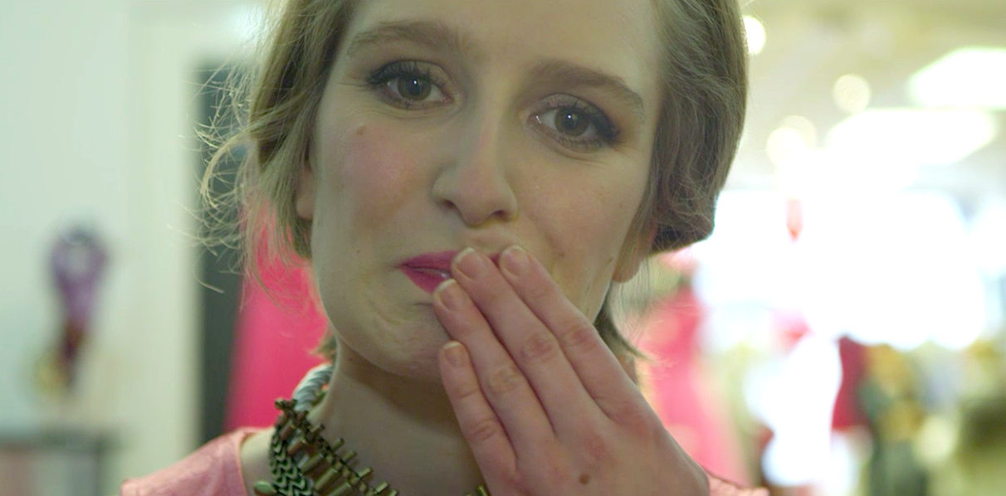
But the final word goes to ‘Belle’
“It shows how difficult I find the work. She is wearing a lot of makeup which is unlike me in my ‘real’ life but exactly like me in my working life. Her expression is emotional – just how I feel before seeing a client. She also looks shocked.
After seeing a client that is exactly how I feel; quite shocked by what I have just done. Sometimes I think it is the only thing in my life and the only thing that identifies me.
Everything else is just background noise and this is also reflected by the blurred background in the image. Even four years later I find it hard to believe what I am doing. I’m so alone and I think that this image shows this. Clients do not see or know anything about who I really am. They do not know what I do, what I like, dislike etc. I tell them a different story.”
Notes:
15

Slide 16
Thank You

