Slide 1
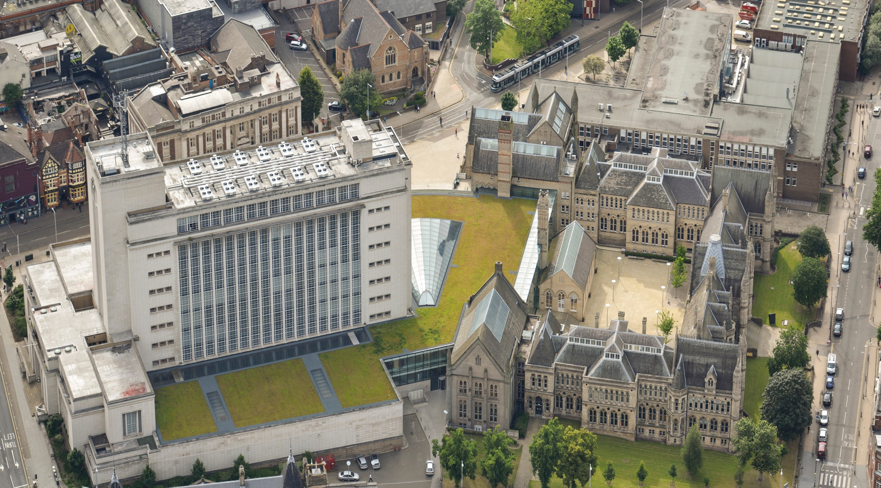

Slide 2
Learning Together: What role for partnerships and a dialogic pedagogy?
Anne O’Grady, Paul Hamilton, Kirsty Teague

Slide 3
Overview
Learning Together
the policy
the programme
the partnerships
the practice (pedagogy)
the positives
the problems
Conclusions and next steps
www.ntu.ac.uk

Slide 4
The Policy: Current Education Picture in England
Unlocking Potential - A review of education in prison (Coates, 2016)
Education and Employment strategy (MoJ, 2018)
Annual Report of Her Majesty’s Chief Inspector of Education, Children’s Services and Skills 2019/20:
2019/20 inspections reveal a declining picture of quality in relation to prison education.
Leadership in Prison Education (Saunders, 2020)
Education Committee: Education: Are Prisoners being left behind (2021)
Numbers of prisoners engaging with prison education are declining (78,000 in academic year 2017-18 – a 12% drop on the previous academic year) (Prison Reform Trust, 2021)
Approximately 2,000 prisoners in higher education. Prisoner participation in higher education has been estimated to cut reoffending rates by 20-40%(Prison Reform Trust, 2021)

Slide 5
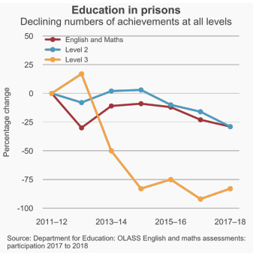

Slide 6
The Programme
In a nutshell:
‘Bringing students in Prison and University together’
An educational initiative that brings together students in prison and university to study together.
Students from universities and prisons are able to learn together and learn from one another in an innovative method of knowledge exchange.

Slide 7
The Programme
Learning Together aims to:
Add to narrative about the role of education in a penal setting (underpinned by ‘real talk’ about what is prison for and what we mean by justice);
Contribute to the development of a shared understanding of learning and lived experiences between HE learners and HMP learners;
To enable a parity of quality HE experiences across different institutional boundaries;
To challenge the invisibility of all learners involved in the project;
Provide opportunities for a sharing of interdisciplinary knowledge;
Opportunities for all students to understand their role and responsibilities in society in relation to social justice and civic engagement;
Provide a space for critical discussions in small groups, placing them at the centre of the learning experience.

Slide 8
The Programme
Considers key education theory and penal debates including: i) what is prison (education) for?; ii) philosophies of punishment; iii) oppression and emancipation; iv) desistance theory; and v) intervention strategies and;
Prior to each session students are required to undertake some independent reading – usually of two articles on these subjects;
During the session students are introduced to the topic by the lead lecturer, and then invited to discuss the material in small groups, facilitation by a set of structured questions;
Throughout the course students are required to complete a group project, and be prepared to present this to an audience at the end of the course;
Successful graduates (HMP and NTU) of the Learning Together course receive a certificate.

Slide 9
The Partnerships
HMP Lowdham Grange
Category B
Three programmes
HMP Whatton
For people convicted of a sexual offence
Three programmes
HMP Sudbury
Category D
One programme
ROTL shared between HEi and HMP campus

Slide 10
The Practice (pedagogy)
Based on the philosophy of Paulo Freire (1996)
Critical pedagogy, rather than ‘banking model’
Student-teacher dualism- consciousness co-construction of new understanding
Cultural action, rather than culture of silence
Emancipatory, rather than oppressive
Participatory and dialogic

Slide 11
The Positives
Student Experiences of Learning Together
The value
The changes in perspectives and understanding
The challenges of assumptions

Slide 12
The Problems
Institutional Bureaucracies:
Risk Assessments
Fear
Legitimacy and Ownership
Security
Technology

Slide 13
The Learning
Research focus sought to:
Understand whether a culture of innovative learning can be established; and how pre-conceptions of groups can be challenged and deconstructed within a learning space.
Add to the narrative about the role of education within a penal setting; and create visibility of marginalised groups in our society and challenge their invisibility.

Slide 14
Findings: outcomes
Identity
Agency:
“LT [Learning Together]—never have an opportunity to speak with people—‘education is education’… great to share platform—‘air of normality’ to the process of education” (HMP 4)
Empowerment v Oppression
LT—people from the prison “in power”: The point of LT was for us to learn in a learning space without the “prison” guard watching reminding you—you are prisoners; when students spoke—powerful support, prisons like to remind us—know your place—you are prisoners. (HMP 6)
Challenge of stereotypes:
“Divide—social barriers; didn’t feel like ‘good little prisoner’” (HMP 3).
“You sometimes forgot they were in prison at some points in the course … this was a real surprise to me” (HE 2).

Slide 15
Findings: outcomes
Education
Culture
“Prison education—‘horse to water’ can’t make those learn who don’t want to; LT education experience— people wanting to learn, share ideas, having opinions, have a space to speak and listen—right to have a view.” (HMP1)
“It was a bit depressing to see how the education needs of these guys [prisoners] are often overlooked. How are we ever going to achieve better rehabilitation outcomes if we don’t focus on education? I just don’t think there’s enough focus on rehabilitation. When they do get offered education, it’s more to tick a box and to bulk up their files and to say they’re more of a low risk.” (HE7)

Slide 16
Findings: outcomes
Power
“LT—gaining an insight into our place in society—wished someone had explained earlier—learning not that much different as anyone else—aspiration to be the same—prison record—just one more hurdle.” (HMP 5)
Change
“Education is about learning about yourself – that is how identity change happens. At the same time, I realise that there are other things that are important, but I think that what LT has done is broaden my understanding of what education is.… there should also be flexibility on what prisoners want as well because there’s a minority that go into prison very well educated with degrees, so what’s the point in them sitting there doing English and Maths?… We should focus on the basics for those who can’t read and can’t write, and there should be more options for those that are already educated.” (HE 4)
“LT—breaking down barriers—participation to tell other people; platform makes you realise you can see prison as a campus—educate or educate yourself. In your mind you are not in prison.” (HMP 4)

Slide 17
Findings: outcomes
Institutional
Powerlessness v Empowerment
“It [delayed prison movement] just sends out a message that staff don’t really care about these guys. Where’s the respect … for their agency and control of their lives? In the prison, it is the smallest things that can mean the most … time especially.” (HE4)
“Up until the point that you and [teacher] met us in the library a week before, I had absolutely no idea what Learning Together was about” (HMP7).
“When I was doing Learning Together it didn’t feel like I was in prison for that day” (HMP8).

Slide 18
Findings: outcomes
Othering
“The one thing I was really happy about was the solidarity with the bibs” (HE7)
“Bibgate for me was … a power struggle. After everything we had talked about in Learning Together, we weren’t going to be told what to do” (HMP7)
Censorship
“It’s quite distressing about how many [prisoners] don’t seem to have a voice. [prison staff] definitely stifled the conversation at times; I don’t think the HMP guys felt they could always express themselves in the way they wanted, because it might go on their file or jeopardise their application for other education courses or whatever.” (HE7)
“Difficult to voice opinions when prison staff were there. Shot down or told that my opinions were not allowed and that we were “drama queens”. I definitely think we wanted different things from it [LT] than prison staff.” (HMP7)
Long Term
“Learning Together was genuinely great because it helped the prisoners see that we valued them as individuals on the same path on the same level in that learning space” (HE10)
Learning Together took my mind off the outside world; nice bit of escapism …. Back on the house block, it was the “same old, same old” and you realise that the way that staff treat you and that hasn’t caught up.” (HMP3)

Slide 19
Findings: outcomes
Long Term
“Learning Together was genuinely great because it helped the prisoners see that we valued them as individuals on the same path on the same level in that learning space” (HE10)
Learning Together took my mind off the outside world; nice bit of escapism …. Back on the house block, it was the “same old, same old” and you realise that the way that staff treat you and that hasn’t caught up.” (HMP3)
“I used to think “they’re all criminals, they’re all on a holiday camp”, but I’ve definitely changed my attitude full circle on this. It … made me realise what it actually means to lose your liberty. Everyone is like “holiday camp”, but imagine having to ask every time you wanted to go to the toilet, or to fill up your drink? Every time there was a setback, they were frustrated … they were just sat in their cell waiting to go to Learning Together; it’s all about their lack of agency.” (HE3)
“I had no pre-judgements of the Uni students…. I was more uneasy about being in a room of new people and a fear of being judged and labelled as ‘just a guy in prison’. So yeah, it was more about what they were thinking about me and how that would make me feel.” (HMP7)
“I think it was important for people in prison to realise that they can have conversations as a student, as a human, not as this label of an inmate. I think that they were equal in that room and could be who they wanted to be, say what they wanted to say without it going against them.” (HE2)
“I was so surprised about … how there was much more that bound us together, rather than separated us” (HE4).

Slide 20
Findings: outcomes
Cultural rippling
“I think it was important for people in prison to realise that they can have conversations as a student, as a human, not as this label of an inmate. I think that they were equal in that room and could be who they wanted to be, say what they wanted to say without it going against them. (HE2)
“I was so surprised about … how there was much more that bound us together, rather than separated us” (HE4)
“At first, [my mum] was a bit worried, but coming on the celebration event and listening to me has changed the way that she thinks.… When she walked in the room [celebration], she didn’t realise who was who and I think that she was really interested when she spoke with some of the students we worked with. She was “I’m so glad I came and it has really made me think differently about the prison system.” (HE2)
“It’s changed me because I feel very much that I want to be more of an advocate, more of a voice for what goes on in prison…I feel passionate about trying to influence a small change wherever I can.” (HE10)
“Loads of people asking about it [LT] at work and on the wings. Shared readings with other prisoners. Appetite for other people to be involved” (HMP1)

Slide 21
Concluding thought
Ultimately, as one HE learner powerfully commented,
“it is our generation who have the opportunity to change the way that prisons are run and how we view education in prison” (HE7).

Slide 22
Next Project: Higher Education Distance Learning in Prisons
Prison-based higher education distance learning for long term prisoners
Currently limited opportunities /access to higher education; prisoners need to meet specific criteria.
Builds on our work with Learning Together programmes.
During the COVID-19 pandemic, prison education has struggled to maintain any significantly meaningful education offer; largely because of the limited availability of IT throughout the prison estate.
The project will develop a distance learning module, drawing on a range of in-cell technology; and test its feasibility in a custodial setting, piloting with long serving prisoners (10 years plus).
The findings will provide important learning for higher education institutions aiming to provide an undergraduate distance learning portfolio offer for the prison estate.

Slide 23
References
Coates, S (2016) Unlocking Potential: a review of education in prison, London: Ministry of Justice Unlocking potential A review of education in prison (publishing.service.gov.uk)
Freire, P. (1996), Pedagogy of the oppressed. Rev. Ed, Harmondsworth: Penguin.
Ministry of Justice (2018) Education and Employment Strategy, London: The Stationery Office.
O’Grady, A (2021) Submission of Evidence to the Education Committee Inquiry: Education: Are prisoners being left behind? Education: Are prisoners being left behind? - Committees - UK Parliament
O’Grady, A. and Hamilton, P., (2019) ‘There’s more that binds us together than separates us’: exploring the role of Prison-University partnerships in promoting democratic dialogue, transformative learning opportunities and social citizenship, In: Journal of Prison Education and Reentry: https://scholarscompass.vcu.edu/jper/
O’Grady, A and Hamilton, P (2017) Re-Imagining The Prison Education Paradigm: identity transitions, social learning and ‘de-othering’ in a climate of penal exactitude. In: Crane, P., 2017. Life Beyond Crime. London: Lemos & Crane.
Prison Reform Trust (2021) Bromley Briefings Prison Factfile; London: Prison Reform Trust, Winter 2021 Factfile final.pdf (prisonreformtrust.org.uk)
The Centre for Social Justice (2021) Digital Technology in Prisons, unlocking relationships, learning and skills in UK prisons, London: The Centre for Social Justice CSJJ8671-Digital-In-Prisons-INTS-210114-WEB.pdf
Saunders, A (2020) Leadership in Prison Education: Meeting the challenges of the new system, London: Prisoner Learning Alliance, https://prisonerlearningalliance.org.uk/wp-content/uploads/2020/02/PLA-FETL-Leadership-in-Prison-Education-report.pdf

