Slide 1

Criminal Law Concepts- Dishonesty
Title
Click on the sound icon on each slide
for the accompanying audio
Cerys Davies - Lecturer

Slide 2
Why is ‘dishonesty’ a key concept?
Crucial element in a number of criminal offences, e.g:
Theft
Fraud
Obtaining property, pecuniary advantage or
services by deception
Burglary
Robbery
False accounting

Slide 3
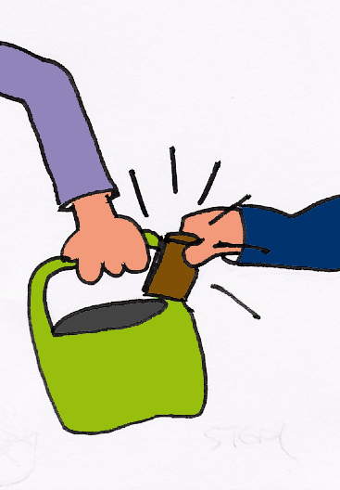
Theft
Theft Act 1968
Locate via www.legislation.gov.uk
Section 1 (1) of the Theft Act :
“A person is guilty of theft if he dishonestly appropriates property belonging to another with the intention of permanently depriving the other of it...”

Slide 4
Theft
“A person is guilty of theft if he dishonestly appropriates
property belonging to another with the intention of
permanently depriving the other of it…..”
Appropriates (section 3 TA)
Property (section 4 TA)
Belonging to another (section 5 TA)
With the intention of permanently depriving the other of it (section 6 TA)
Dishonestly (section 2 TA)

Slide 5
Theft Act 1968 - Section 2 (1)
“ A person’s appropriation of property belonging to another is not to be regarded as dishonest –
If he appropriates the property in the belief that he has in law the right to deprive the other of it….or
If he appropriates the property in the belief that he would have the other’s consent if the other knew of the appropriation and the circumstances of it, or
…….if he appropriates the property in the belief that the person to whom the property belongs cannot be discovered by taking reasonable steps.”

Slide 6
If section 2 (1) does not apply…. look to the Common law.
Common Law? Law arising from judicial decisions made in courts
Creating Precedent - followed thereafter by lower courts
Test for dishonesty initially established in R v Ghosh [1982] EWCA Crim 2
Ghosh Test = Jury should ask themselves:
1) was the conduct dishonest according to the standards of
reasonable people, but then..
did the Defendant herself realise that her conduct was dishonest
(this last criticised as being problematic …… and so……)

Slide 7
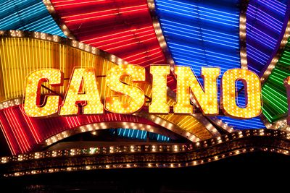
……..and so to Ivey
Ivey v Genting Casinos [2017] UKSC 679
(locate via www.bailii.org)
Ivey changed the test for dishonesty
New Ivey test = Jury should ask themselves:
1) given the Defendant’s knowledge and belief as to the facts,
2) was the Defendant’s conduct dishonest
according to the objective standards of ordinary decent people.
This Photo by Unknown Author is
licensed under CC BY

Slide 8
Ivey test for dishonesty… better or worse?
Advantages:
Appears straightforward for a Jury
Outcome not dictated by the Defendant’s morality
Permits a common-sense approach to each set of facts
Issues:
Number of criticisms
Is there really a shared set of agreed standards?

Slide 9
Further study 1… scenarios
In each of the 3 hypothetical scenarios which follow:
Decide whether you consider the conduct to be dishonest
Then ask as many friends and family the same question. Is there any divergence of opinion?
Then look up and read the case or article referred to - this will be good practice for working out how to look up cases using www.bailii.org , how to read a judgement and how to read academic articles. Consider the relevance of the case or article to the scenario

Slide 10
Scenario #1
Lock-down is over!! You have been out with friends until 10pm and you are walking home when it begins to rain. Heavily. Passing a charity shop doorway you notice a bin bag of items clearly left as a donation. Among the items is an umbrella. You take the umbrella – leaving a £1 coin on the bag in return.
Conduct honest or dishonest?
Would everyone agree?
Look up via www.bailii.org and read Ricketts v Basildon Magistrates Court [2010] EWHC 2358

Slide 11
Scenario #2
It’s Easter! Walking alongside a busy road with a group of friends you are passed by a huge HGV lorry. As it hits a pothole the rear doors swing open and thousands of Crème Eggs burst forth – rolling on to the road, the pavement, into the verges and under the wheels of other vehicles. You and each of your friends pick up one Crème Egg each, and eat it.
Conduct honest or dishonest?
Would everyone agree?
Look up the incident of the wrecked ship, the MSC Napoli, via http://news.bbc.co.uk/1/hi/england/devon/6287457.stm

Slide 12
Scenario #3
Your expensive and exclusive gym has re-opened and you can’t wait to get back to using it. Waiting outside in a long queue for the gym to open you realise that your membership card expired a month earlier. You will happily renew your membership later, but you don’t want to waste another second before getting back on that gym equipment. So, when the doors open, you just wave your expired card at the receptionist and hope he doesn’t check it. He doesn’t. You’re in!
Conduct honest or dishonest?
Would everyone agree?
Look up and read, on www.bailii.org the case of R v Lambie [1982] AC 449

Slide 13
Further study 2… the other elements of Theft
At the beginning of this presentation, you learnt that there are 5 elements which need to be established for a successful conviction for Theft. In each of the 3 hypothetical scenarios which follow:
Consider whether establishing each of the 5 elements is straightforward or whether one or more of the elements may be problematic.
This will be good practice for approaching Problem scenarios in your Law studies. Work through the 5 elements methodically, ensuring you refer to the appropriate sections in the Theft Act 1968 for assistance with the definitions
(locate via www.legislation.gov.uk )

Slide 14
Scenario #1
You take your parent’s golf clubs to go and play a round with friends.
Elements of Theft:
Dishonestly (section 2 TA and Ivey)
Appropriates (section 3 TA)
Property (section 4 TA)
Belonging to another (section 5 TA)
With the intention of permanently depriving the other of it (section 6 TA)

Slide 15
Scenario #2
You dispose of your sister’s headphones, mistakenly believing them to
be your broken ones.
Elements of Theft:
Dishonestly (section 2 TA and Ivey)
Appropriates (section 3 TA)
Property (section 4 TA)
Belonging to another (section 5 TA)
With the intention of permanently depriving the other of it (section 6 TA)

Slide 16
Scenario #3
After leaving a shop you notice that the store assistant has given you change from a £10 note, when you had actually paid with a £5 note. ‘It’s my lucky day’ you think as you head for the coffee shop.
Elements of Theft:
Dishonestly (section 2 TA and Ivey)
Appropriates (section 3 TA)
Property (section 4 TA)
Belonging to another (section 5 TA)
With the intention of permanently depriving the other of it (section 6 TA)
….........and finally………

Slide 17

Some additional reading……
There are a number of articles on the issues surrounding the definition of ‘dishonesty’. Many, however, are only accessible on sites for which you need a subscription. You will have access to all of these sites when you begin your studies. Until then, here is one article which is accessible for free:
Virgo, ‘Cheating and Dishonesty’ (2018) 77 Cambridge Law Journal 18
Accessible via:
https://www.cambridge.org/core/journals/cambridge-law-journal/article/cheating-and-dishonesty/9B8EFE2AE2FB868201C177874F803CF4/core-reader
Finally…. well done for making the effort to work your way through this and best of luck with your future studies.

Slide 18
Thank you and best of luck!

