Slide 1


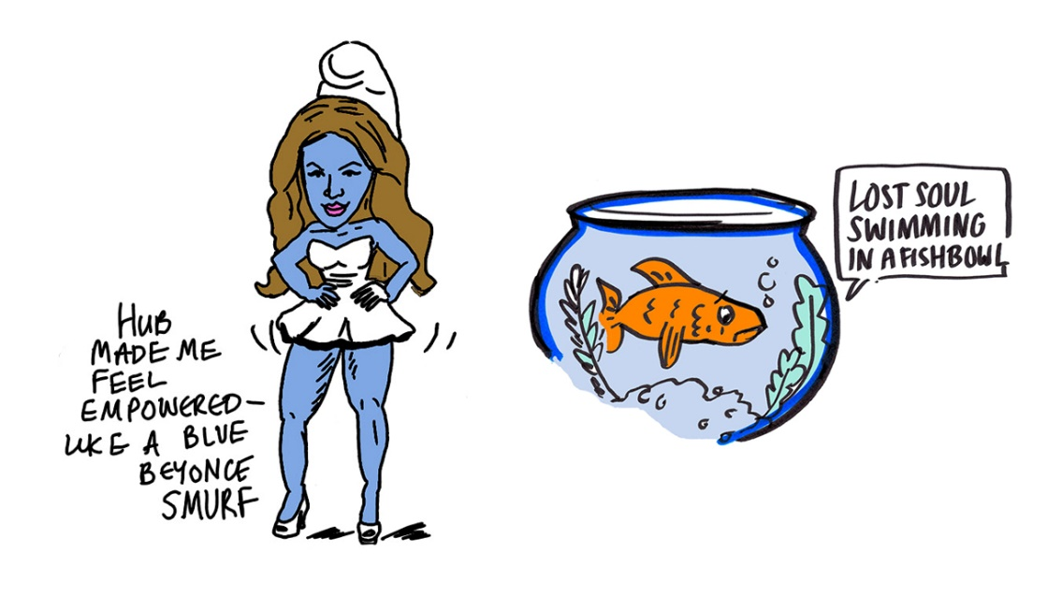
Conversations: Community, Higher Education & Desistance
Debbie Jones & Mark Jones
Notes:
Mark

Slide 2
Setting the Scene
Desistance – marriage, family, employment, health, & education
‘Bridging social capital’ (Weaver & McNeill, 2015: 101)
A replacement self / non-criminal identity (Giordano et al, 2002 & Abeling-Judge, 2016)
Hook for change (Runnel, 2017)
The pains of desistance (Nugent and Schinkel, 2016)
HE & D still under-researched especially within community development setting
Widening Access and the Neo-Liberalist University (Evans et al, 2017)
PET (2017) HE sector could do more to support belonging
Notes:
Mark
Education & especially HE has been seen to increase positive life outcomes and D from crime – So HE is aspirational like home, health, family, employment
Key to D seems to be the creation and maintenance of new social identities and new social networks “interdependent systems of obligation and restraint” which lead to development of a non-criminal self-identity – father, mother, partner, employee, friend or is this case fellow students (Abeling-judge, 2016:1240)
HE and D is still quite under-researched in prison settings and especially so outside prison environments with previous offenders
Widening Access & Neo-Liberalist university and money model versus part time multi barriered adult learners
We decided to explore some of these under-researched areas within Swansea locality

Slide 3
Aims & Questions
Explore whether higher education is viewed as a ‘hook for change’ by adults outside of the prison environment.
Does HE have potential to raise aspirations & support desistance and new identities.
What are the aspirations to study within HE?
What barriers/problems/challenges do this group envisage in engaging with HE?
What support would this group need to engage with HE?
How might HE support desistance from offending?
Notes:
Mark

Slide 4
Research Design
AOP approach & Research ‘with’ and not on
Multiple Stakeholders
Include http://include-uk.com/who-we-are/
Prison Education Trust
Prison staff
Local FE College
Pictorial Narrative Mapping & Analysis (Lapum et al., 2015)
Focus group, short survey and stakeholder focus group
Notes:
Debbie
So what approach did we take to the design of the project?
We are both committed to the ideology of Participatory non oppressive methods of inquiry so we opted for a model that facilitated buy in from many different stakeholders.
We partnered with a third sector organisation Include who deliver community interventions for those at risk of offending re/offending, we have been working with PET and Swansea Prison and also with a local FE College
And we wanted to create something that moved beyond the spoken or written word so we employed a Pictorial Narrative Analyst and we are going to share some of the initial findings of that with you today
So we had several phases
Focus group
Short Survey
Focus group with stakeholders
Going to discuss the first phase today

Slide 5
Demographics
16 participants
3 women – one male to female transgender person
13 males – one female to male transgender person
All white aged early 20’s to 60’s
All lived in Swansea locality
All had a criminal conviction
Majority had served custodial sentences
Convictions were for drink driving, assault, drug use
12 males had substance use issues
Most experienced significant childhood & adolescent trauma
All reported mental health ranging from anxiety to atypical personality
3 had experience of HE (2M & 1F)
Notes:
Debbie

Slide 6
Aspirations
Home
Family & Friends
Career / Employment
Health & Well-Being
Security & Future
“I just want to survive”
Notes:
Debbie

Slide 7
Barriers to Aspiration
Money
Crime Identity
Mental Health
Travel
‘The System’
“They don’t want people on courses with problems”
Notes:
Debbie

Slide 8
Educational Experiences
Bullying
Isolation
Trauma
“Not the right time for me”
Prison Education starting point for many
Notes:
Mark

Slide 9
University
Suspicion & Mistrust
Intimidating
Stigma
Not flexible
“Won’t get me a job”
“Only after the money”
BUT…..Would love to go!
“When I walk across campus I hold my head up high..it feels a good place.”
Notes:
Mark
This supports Evans et al (2017) findings that the Neo-Liberalist Uni excludes adult learners from marginalised backgrounds and although all have a widening access agenda or discourse this positive message is lost and does not reach older widening access populations.

Slide 10
Access & Possibilities of HE
Opens doors for future – “prepare for work”
Builds confidence & skills “I’d have more confidence”
Social and Health element – “Be less lonely”
Access, support, funding, small groups
Notes:
Mark

Slide 11
Starting the Conversation
Universities need to develop holistic support for complex needs
University-prison partnership within widening access
Development of HE partnership with community organisations
Specific education & training for HE staff
Introductory & free taster sessions and programmes
Cultural change in HE environment
Notes:
Universities need to develop holistic support for complex needs of mental health, substance misuse issues, stable accommodation & relational insecurities common.
Prison Education can be the hook for change so university-prison partnerships at HE is needed with;
HE partnership with community organisations already supporting such communities to better support desistance
Specific education & training for HE practitioners involved in such projects including teaching & support services
Introductory & free taster sessions and programmes to create a hook for change and break down stigma of University
Ultimately HE needs to create an environment that is accessible, supportive, safe, secure, trusted & familiar
Recovery capital (Cloud & Granfield, 2009) & mutual recognition & respect of the individual, the citizen, civil society, and the state (McNeill, 2018, 2019) = long term Desistance

Slide 12


Mark Jones HigherPlainResearchEducation@gmail.com
Debbie Jones Deborah.A.Jones@Swansea.ac.uk

Slide 13
References
Abeling-Judge, D. (2016). Different Social Influences and Desistance From Crime. Criminal Justice and Behavior, 43(9), 1225-1241.
Cloud, W. and Granfield, W. (2009) Conceptualising recovery capital: Expansion of a theoretical construct, Substance Use and Misuse, 42, 12/13, 1971-1986.
Evans, C., Rees, G., Taylor, C., & Wright, C. (2019). ‘Widening Access’ to higher education: The reproduction of university hierarchies through policy enactment. Journal of Education Policy, 34(1), 101-116.
Giordano, P., Cernkovich, S., & Rudolph, J. (2002). Gender, Crime, and Desistance: Toward a Theory of Cognitive Transformation 1. American Journal of Sociology, 107(4), 990-1064.
Lapum, J., Liu, L., Hume, S., Wang, S., Nguyen, B., Harding, K., . . . Megan Nguyen, L. (2015). Pictorial Narrative Mapping as a Qualitative Analytic Technique. International Journal Of Qualitative Methods, 14(5), International Journal Of Qualitative Methods, 2015 Dec, Vol.14.

Slide 14
McNeill, F. (2018) Rehabilitation, Corrections and Society. Retrieved July 01, 2019, from http://eprints.gla.ac.uk/159625/7/159625.pdf
McNeill, F. (2019). Making Rehabilitation Work for Ex-prisoners. Retrieved June 03, 2019, from https://esrc.ukri.org/news-events-and-publications/news/news-items/making-rehabilitation-work-for-ex-prisoners/
Nugent, B., and Schinkel, M. (2016), The Pains of Desistance. Criminology and Criminal Justice, 16(5) 568-584.
PET (2017). To be truly inclusive, universities must help prisoners feel they belong. Available at: https://www.theguardian.com/higher-education-network/2017/aug/16/to-be-truly-inclusive-universities-must-help-prisoners-feel-they-belong
Runell, L. (2017). Identifying Desistance Pathways in a Higher Education Program for Formerly Incarcerated Individuals. International Journal of Offender Therapy and Comparative Criminology, 61(8), 894-918.
Weaver, B., & McNeill, F. (2015). Lifelines: Desistance, Social Relations, and Reciprocity. Criminal Justice and Behavior, 42(1), 95-107.

